Slide 1

Classes, OOP

Slide 2
Object Oriented Programming
Everything is structured around the manipulation of objects
Classes are types and they are objects functions inside does objects are called methods..
Class
methods
Attributes

Slide 3
Class
Everything in java revolves around classes they are the way of making, changing, structuring things.
class Car {
// variables declared inside class
Engine engine = new Engine(8, 2.4);
Transmision tranmision = new Transmision(6);
Brakes brakes = new Brakes(BrakeType::Drum);
Car(String manufaturer, String model, CarType type) {
// contructor to define the objects inside variables from the outside
}
In the example we see how the engine, transmission and brake objects are created to be used later inside the class, here we also set the engines details, such as the amount of cylinders it has and the volume in litres.

Slide 4
Attributes
Attributes are the variables found inside a class, for example if a car class has the variable: “color”, that would be an attribute.
Attributes can help differentiate between different instances of the same class, etc.
Engine engine = new Engine(8, 2.4);
Transmision tranmision = new Transmision(6);
Brakes brakes = new Brakes(BrakeType::Drum);
String manufaturer;
String model;
CarType type;
Color carColor;
TopSpeed tSpeed;

Slide 5
//function that moves the car, it required you to set what the engine rpm do you want
void run(double rpm){
// in here you can set the engine rpm to the inside engine object.
engine.idle(rpm);
}
void brake(boolean engine) {
if (engine) {
engine.idle(1000);
tranmision.engageClutch();
} else {
engine.idle(1000);
tranmision.disengageClutch();
brakes.engage(40_psi);
}
}
Methods
Here the object run inside the object car talks to the engine object to tell it what to do.
When the brake method is called inside the car, it talks to the engine and transmission.

Slide 6
Inheritance
This mean that a class “gets” from another class. If you have an animal class and you then make a dog class that inheritance the components of an animal. In attributes that would be weight, dimensions, amount of legs, hunger, health, etc.
Inheritance uses the keyword override to override a function that exists in animal and give it the dogs definition.
class Dog extends Animal {
@Override
void eat() {
mouth.open();
}
}

Slide 7
Now that you know what a Class is
Let's make one!

Slide 8
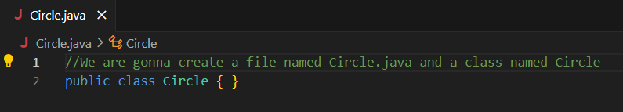
In Java you can only put one class on a file, and the file should be named as the class

Slide 9
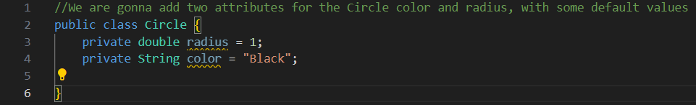
Attributes

Slide 10
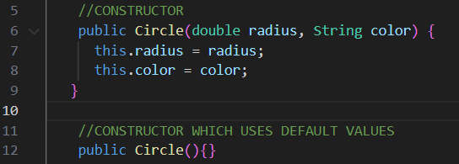
Constructor
Every Class needs to have a Constructor, is a special function in a class that creates the object itself.
this, is used to refer the variables of the class instead of the ones in the function.

Slide 11
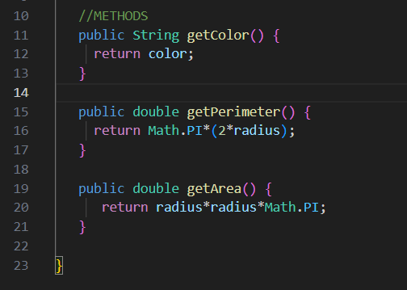
Methods
We are gonna make three methods for our class.

Slide 12
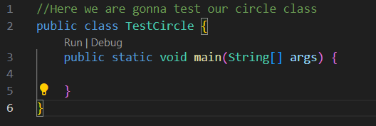
Now we are gonna make another class, our Main class.
The main class is where the program begins running, it is the starting point of a program.

Slide 13
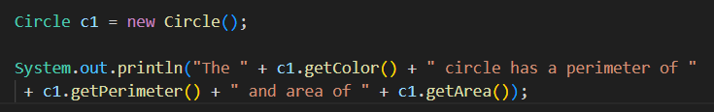
Lets create a circle using only default values

Slide 14
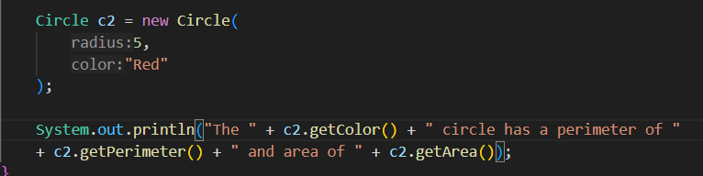
Now lets create another circle using our own specifications.
The cool thing is that when can have various instances of the same object with different attributes.

